Slide 1
Kepler RAG Chatbot*
Shaolin.AI - Project 3
*A ‘conversational Classical Christian curriculum chatbot companion’
Notes:
To be specific, I have built a generative AI ‘thing’ and thereby won the alliteration wars.

Slide 2
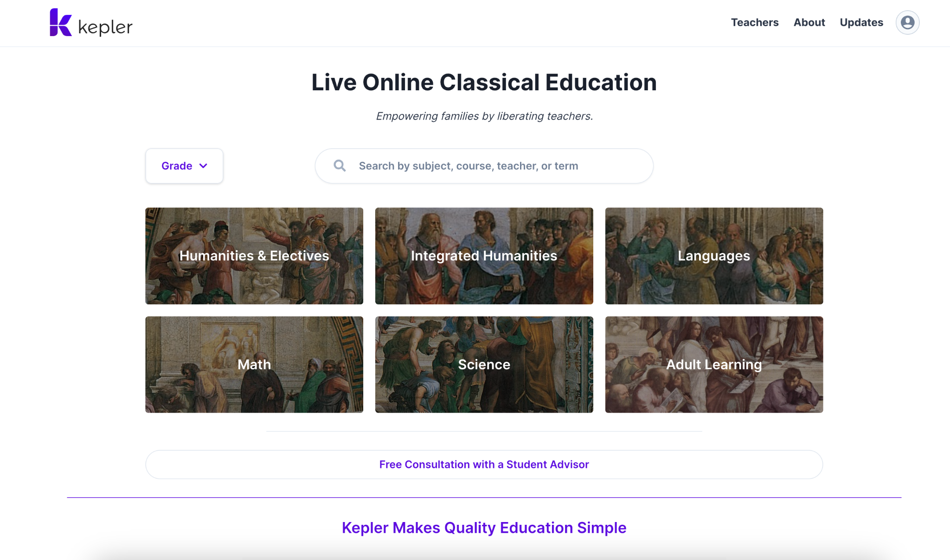
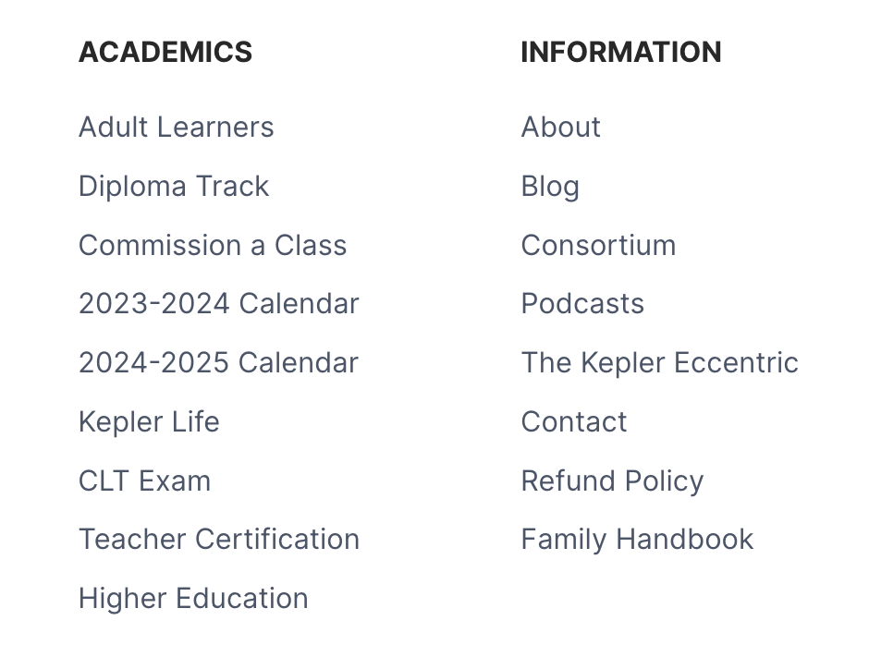

Slide 3
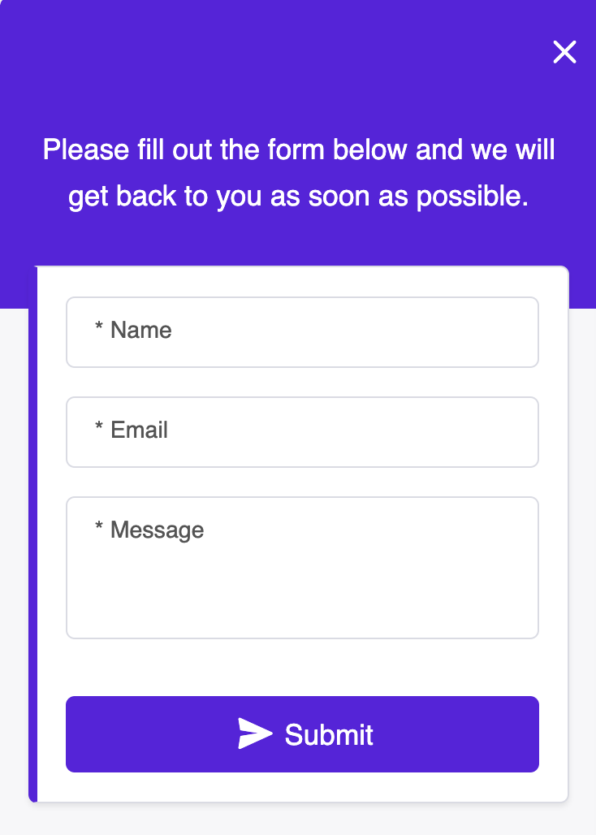
Problem
Email bottleneck
Overloaded human
Extensive information
Repetition of FAQ info
Difficulty to navigate courses

Slide 4
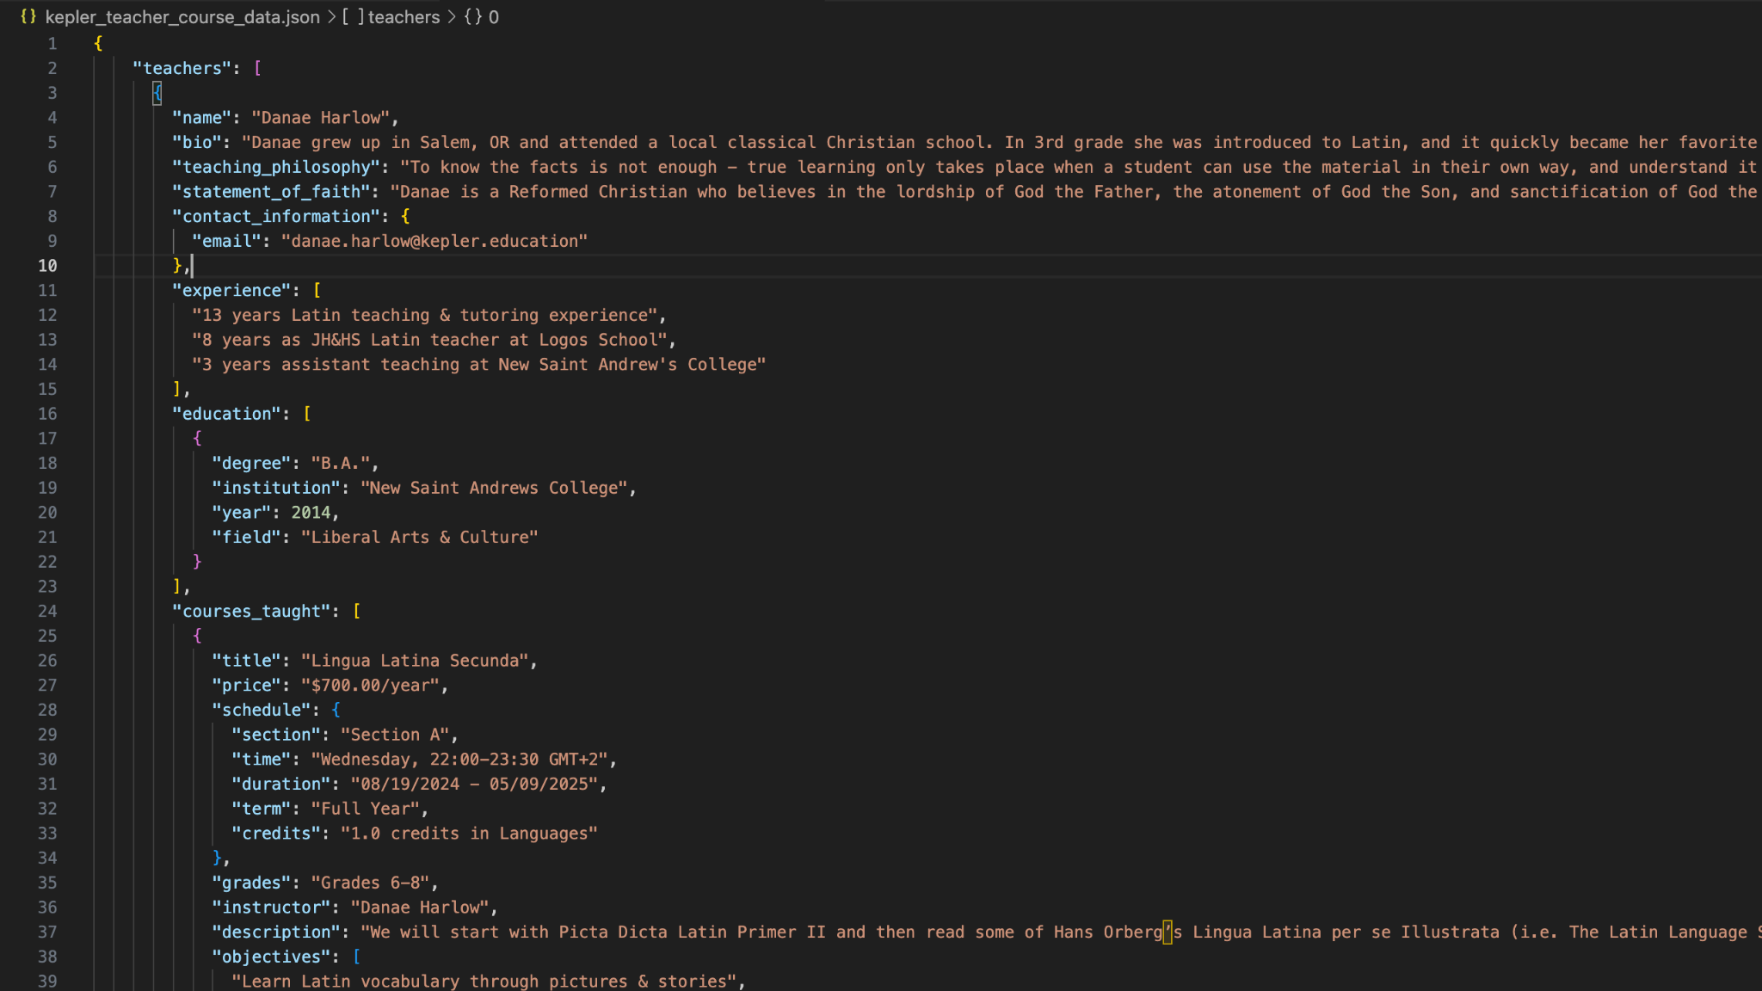

Slide 5
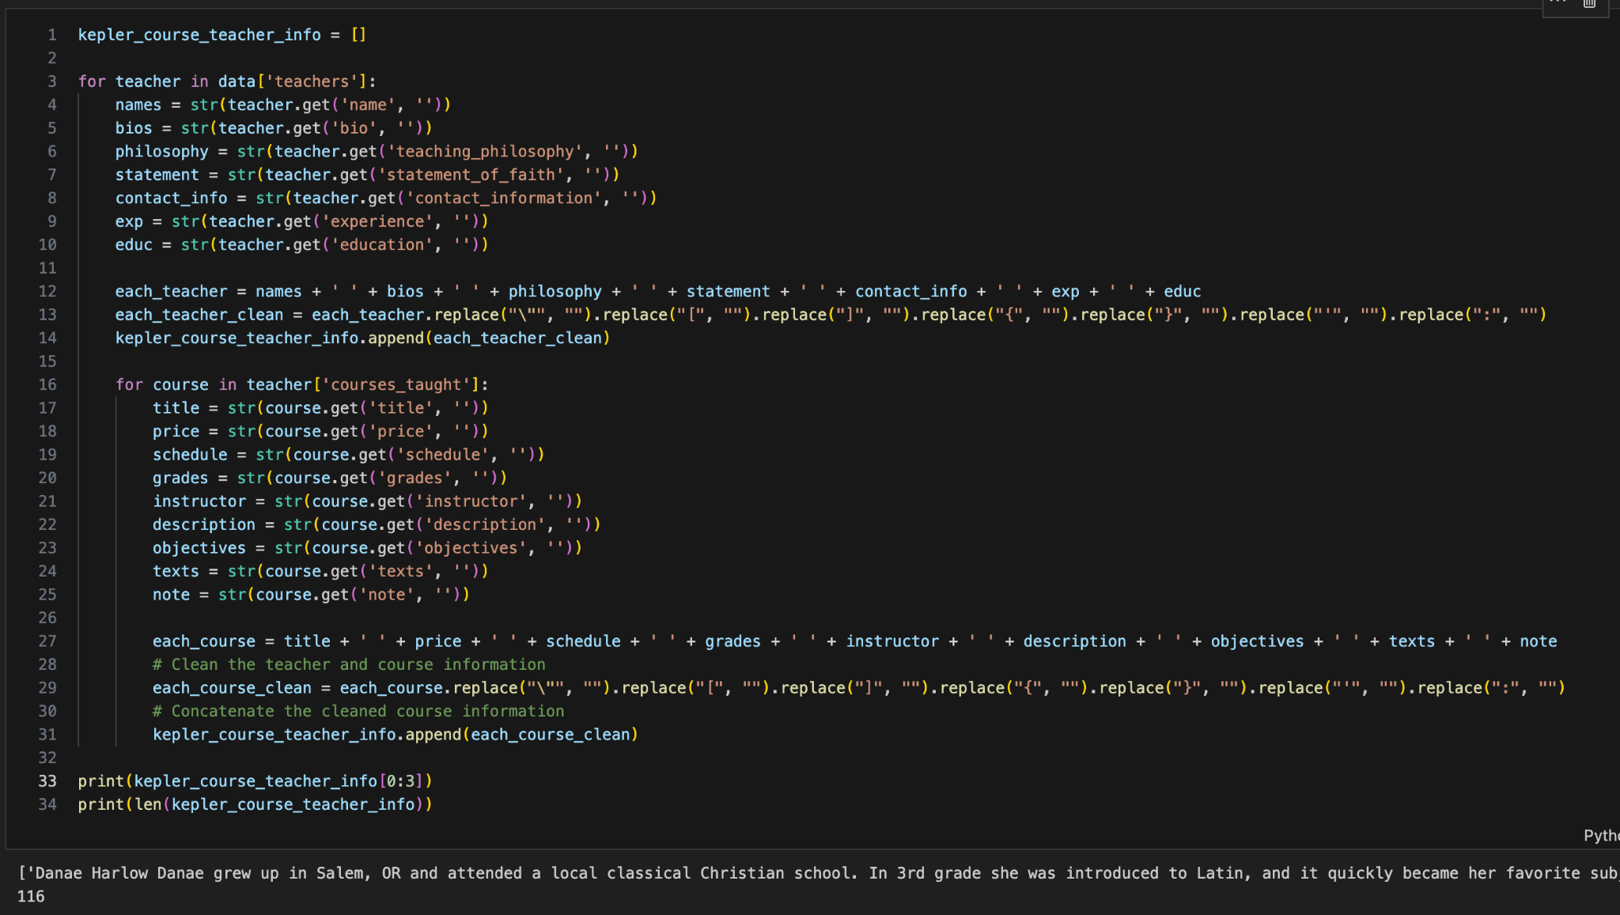

Slide 6
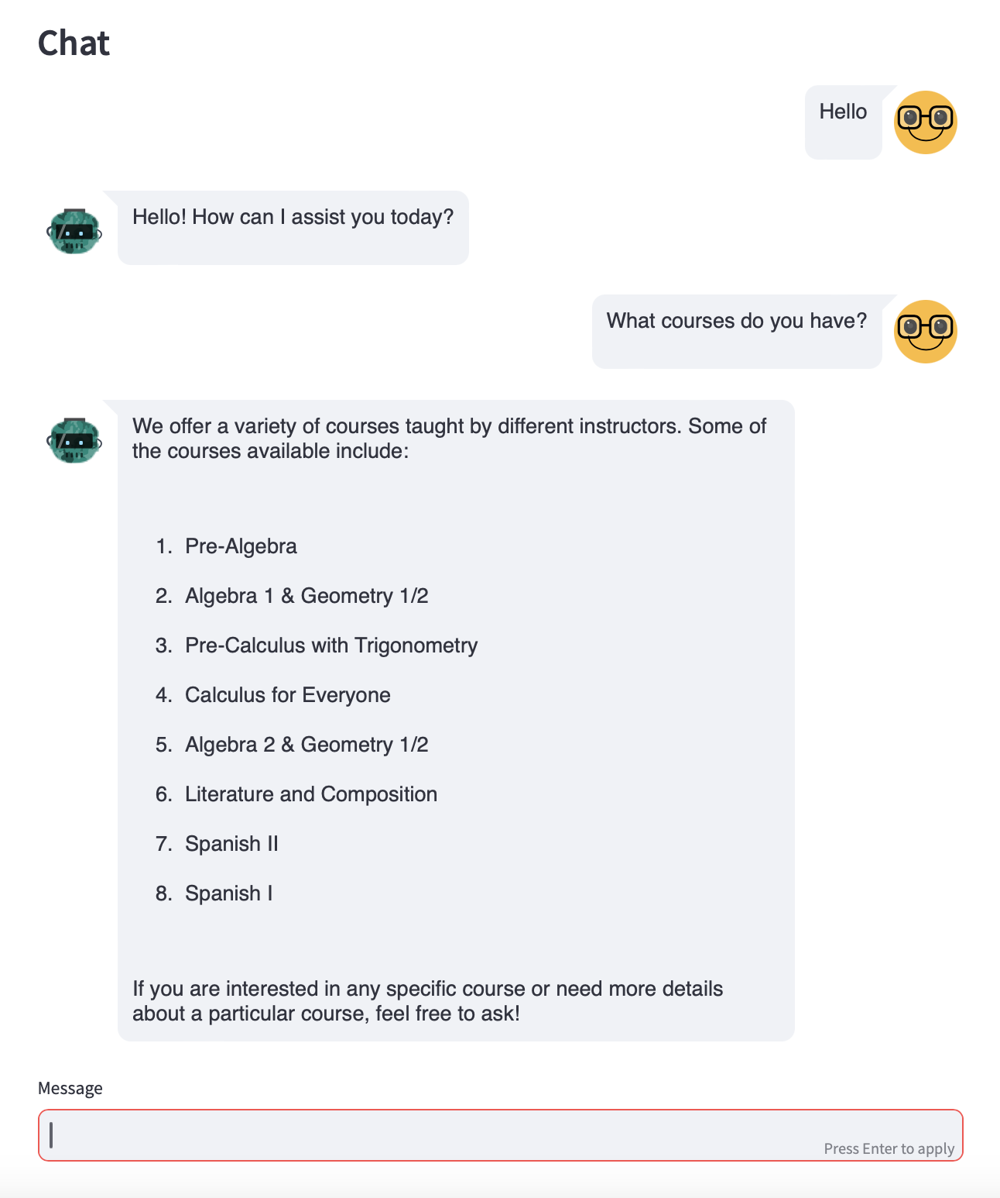
template = """
You are an AI assistant on a homeschooling platform. Answer the question based on the provided context.
If no suitable courses are found, inform the user and recommend one similar course, explaining its relevance briefly.
{context}
Question: {question}
"""
Notes:
Technologies Used: List the technologies and frameworks used (e.g., Python, TensorFlow, APIs).
Code Snippets: Include brief code snippets or pseudocode to illustrate key parts of the implementation.

Slide 7

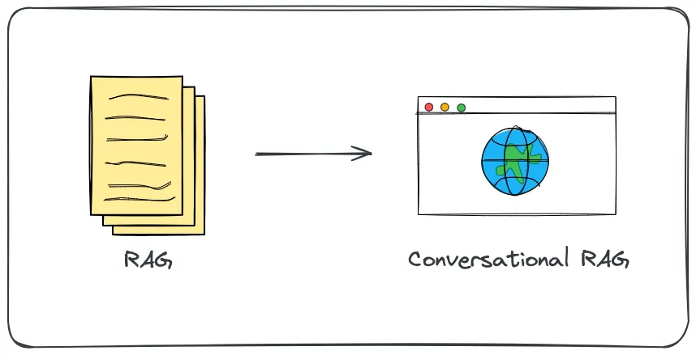

Slide 8
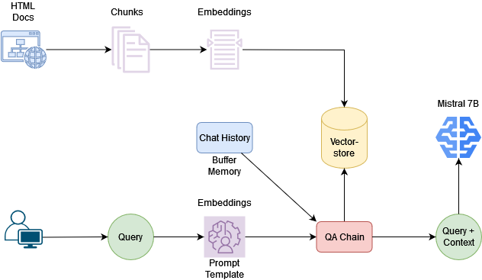

JSON ‘Hell’...
…and looong list of strings.

Slide 9
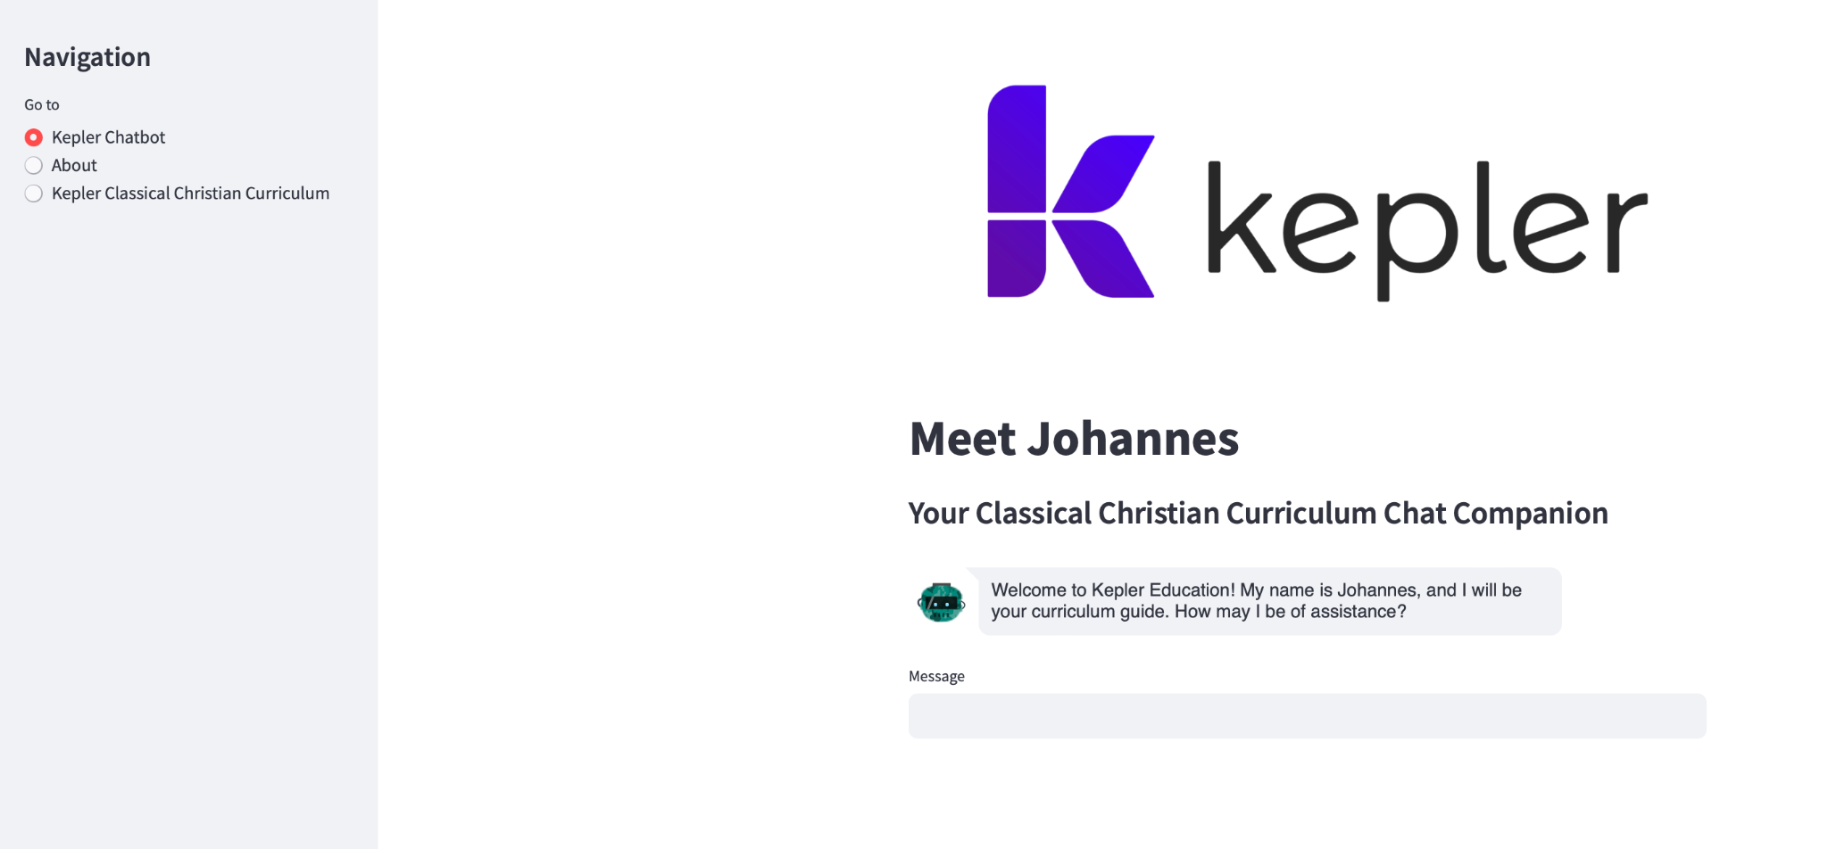
Notes:
Testing and Evaluation
Testing Methods: Describe the testing methods used (e.g., unit tests, user testing).
Metrics: Present the performance metrics (e.g., response accuracy, response time).
Results: Summarize the results from the evaluation.

Slide 10
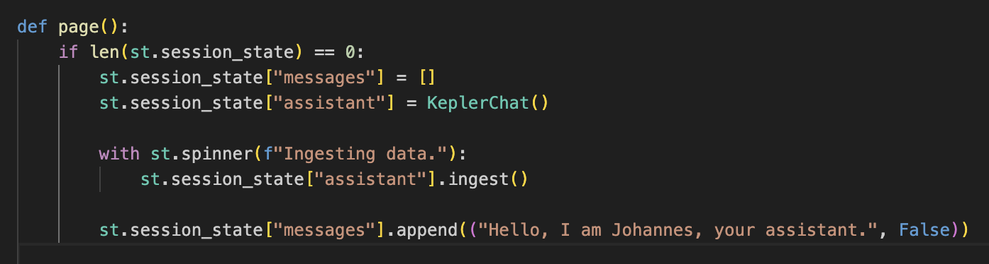
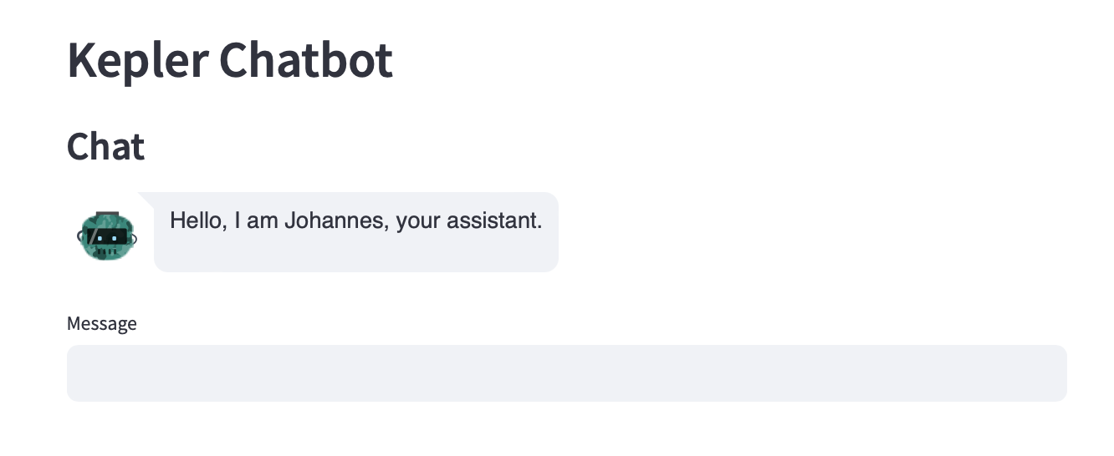


Notes:
Interactivity.

Slide 11
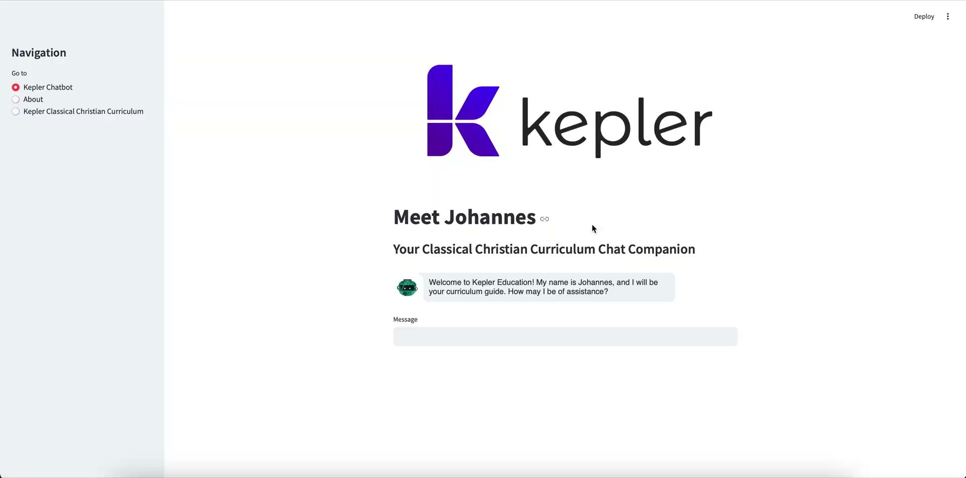
LIVE DEMO
Notes:
If we watch this short demo with the chatbot replies, which I was using as a quick test, there are obviously some improvements needed.

Slide 12
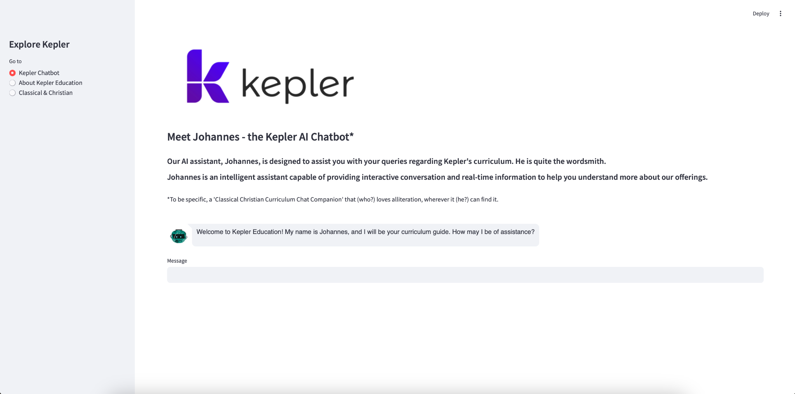
Notes:
Behold, the half-polished Kepler chatbot Streamlit demo.

Slide 13
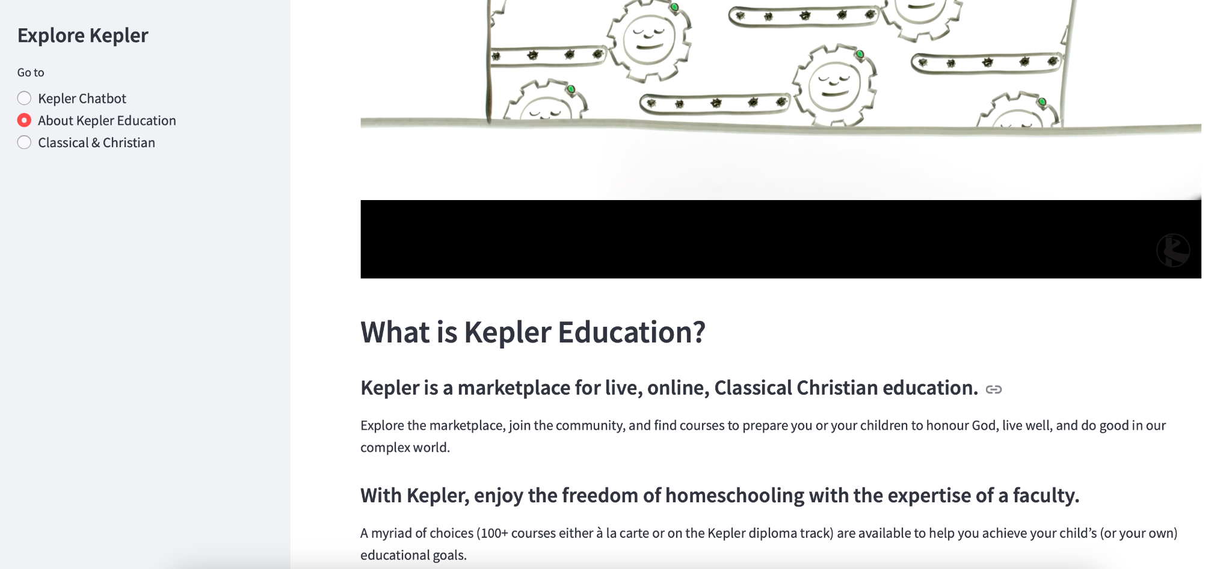

Slide 14
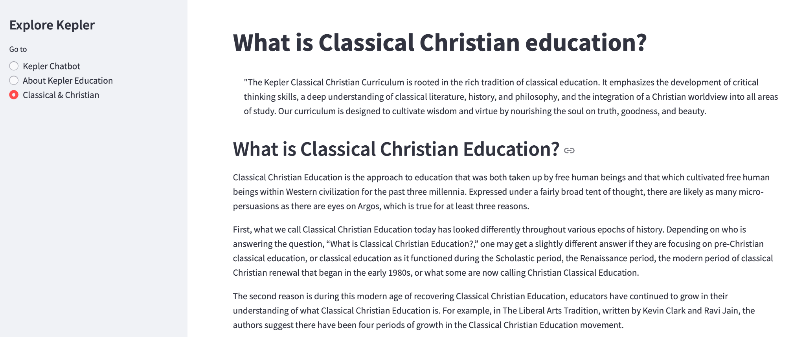

Slide 15

Project Reflection
Challenges and Solutions
User Feedback
Future Enhancements
Notes:
Slide 12: Challenges and Solutions
Challenges: Discuss the main challenges faced during development. JSON!
Solutions: Explain how these challenges were addressed.
Slide 13: User Feedback
Feedback Summary: Share feedback received from users during testing.
Improvements: List any improvements made based on user feedback.
Slide 14: Future Work
Enhancements: Outline potential enhancements and next steps for further development.
New Features: Mention any new features you plan to add.

